Slide 1
ECE 313: PROBABILITY WITH ENGINEERING APPLICATIONS
Fall 2023
Prof. Eric Chitambar
Lecture 20

Slide 2



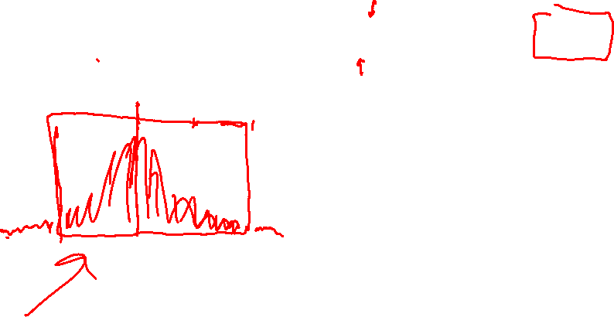
The Gaussian (Normal) Distribution

Slide 3













The Gaussian (Normal) Distribution

Slide 4
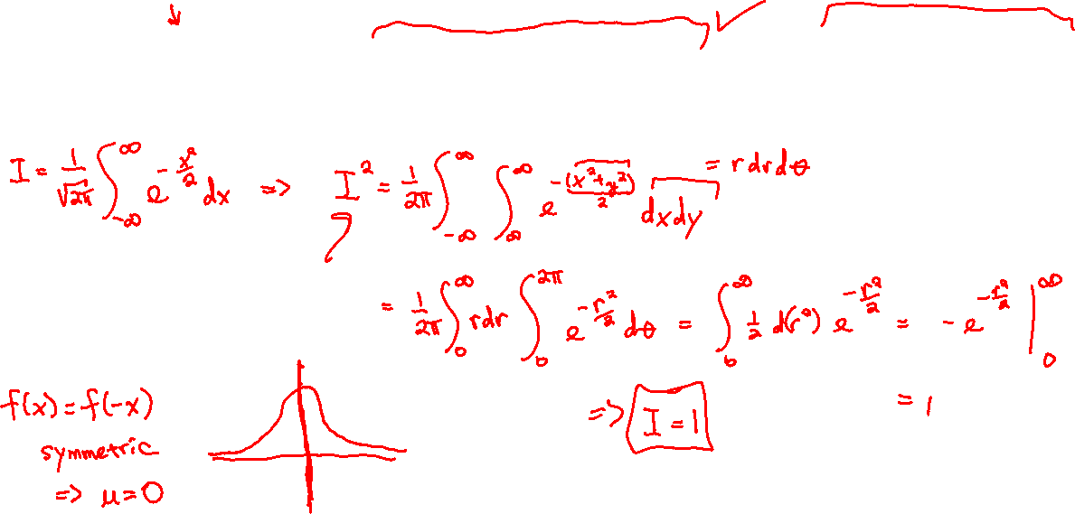
The Gaussian (Normal) Distribution

Slide 5




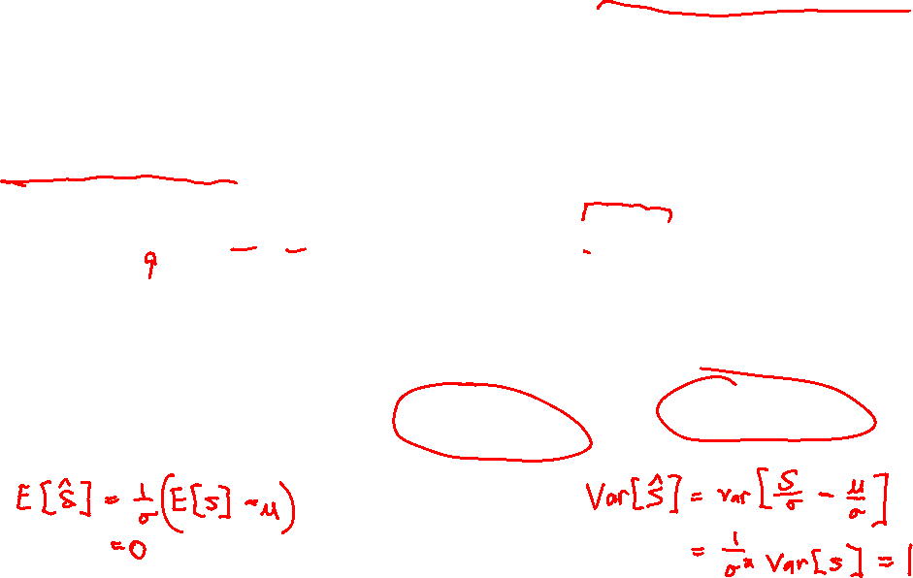
The Central Limit Theorem (for Binomial Dist.)

Slide 6






The Central Limit Theorem (for Binomial Dist.)

Slide 7

The Central Limit Thm Continuity Correction

Slide 8








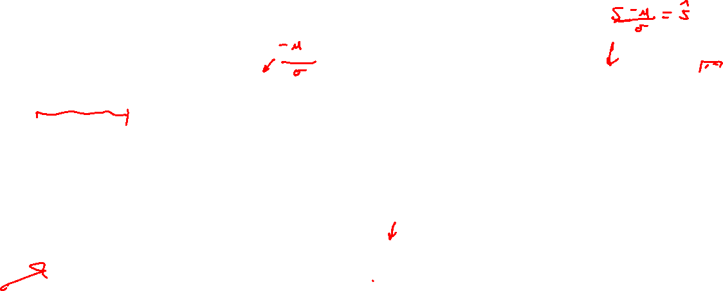
The Central Limit Thm Continuity Correction

Slide 9

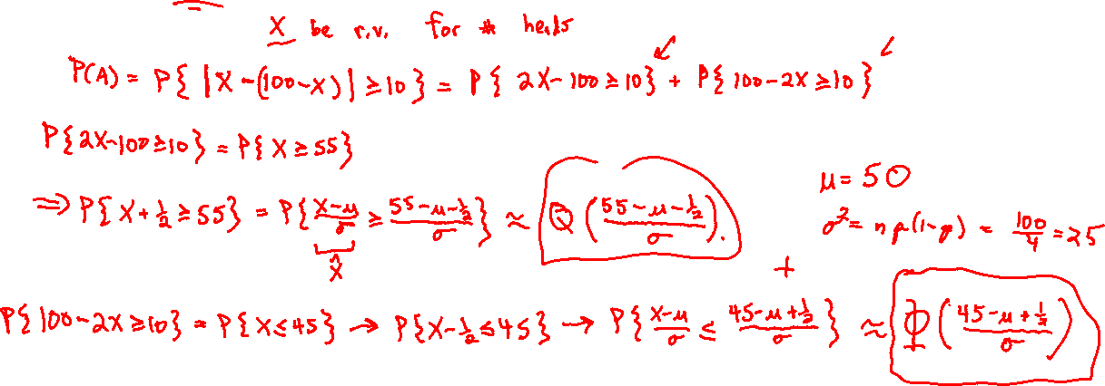
The Central Limit Theorem (for Binomial Dist.)

